Slide 2
The External Economic Action of the European Union and the Sustainable Development Goals
Filippo Fontanelli – University of Edinburgh – filippo.fontanelli@ed.ac.uk
University of Bologna
3 May – 25 May
23 May 2023
Promoting other non-economic goals

Slide 3
Outline of the module
The course’s basic coordinates
  Trade law, investment law and sustainable development: basic notions
  EU competences and policies in trade and investment law
Trade/investment obligations and non-trade values: the return of unilateralism
  The backlash against investor-State arbitration.
  The backlash against trade liberalisation
  Reform proposals for the global investment and trade regimes
  An overview of re-nationalisation trends in trade an investment (US, EU, UK, China)
    Anti-coercion
    Anti-circumvention
    Retaliate against non-MPIA
    Steel row, now sustainable
EU’s external economic action to raise standards abroad
  Free trade agreements and non-economic standards
    Conflict mineral regulation (sort of like diamonds)
    2022 commitment to green trade partnership
    Deforestation MERCOSUR
  Zoom-in: EU dispute with Korea on labour rights
  Zoom-in: level playing field and sustainable development in the Trade and Cooperation Agreement between the EU and the UK
    Mirror clauses
The Carbon Border Adjustment Mechanism
  Overview and assessment of the scheme
  Compatibility with WTO law (China’s complaint at WTO)
  Bonus: carbon removal
Energy (trade)
  EU Net Zero Industry Act and support to renewable energy industry (with assessment of WTO compatibility)
  Reaction to comparable foreign plans (US IRA)
  Zoom-in: biofuels and e-fuels
Energy (investments)
  Foreign investment protection and the fossil fuels industry
  Foreign investment protection and the nuclear energy industry
  Foreign investment protection and the renewable energy industry
  The Energy Charter Treaty, its reform attempts and the withdrawal of EU MS
Controlling trade and investment inbound and outbound flows
  Export restrictions and export controls (including coordinated action with US)
  Critical Raw Materials Act
  EU investment screening
Improving supply chains’ sustainability
  Friend-shoring and sustainable value chains
  Global supply chain due diligence proposal
  EU Guidance to Combat Forced Labor in Supply Chains
  Responsible forestry proposal (trade in forest-risk commodities)
  WTO law-compatibility of these schemes
Promotion of other social interests
  Non-paper of the Commission services 2017 TSD chatpers
  Gender balance in corporate governance in FTAs
  Protection of indigenous peoples’ rights
UNA Europa presentation

Slide 4


Slide 5
the EU is obliged to conduct a value-based trade policy, which includes ensuring a high level of protection of labour and environmental rights as well as the respect of fundamental freedoms and human rights, including gender equality; recalls that all EU trade agreements must include an ambitious and enforceable chapter on trade and sustainable development (TSD); stresses that trading commitments in EU agreements should never overrule human rights, women’s rights or environmental protection, and should take into account the local, social and economic environment;

Slide 6

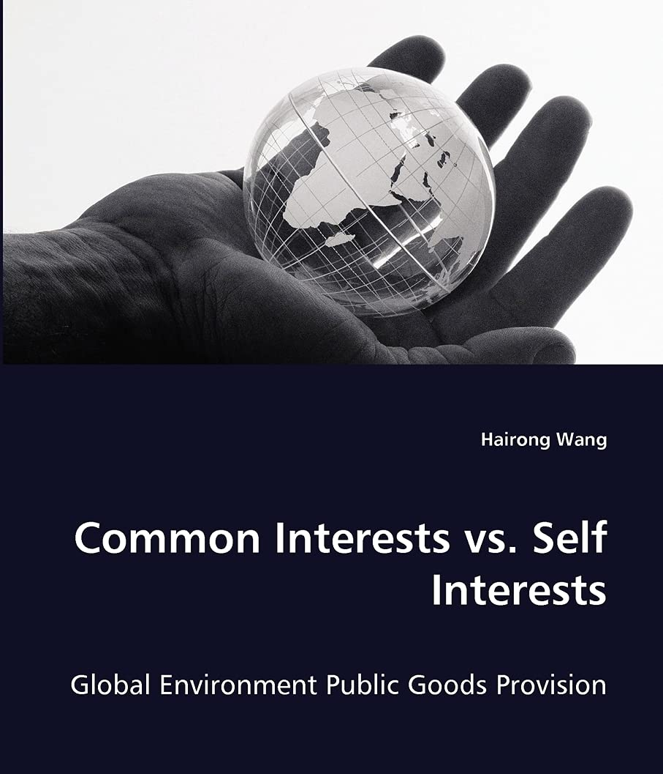
Outline
  Other non-economic interests in FTAs Corporate governance and gender balance
  Labour disputes (zoom-in)
  Rights of indigenous people
  Stock-taking
UNA Europa presentation

Slide 7
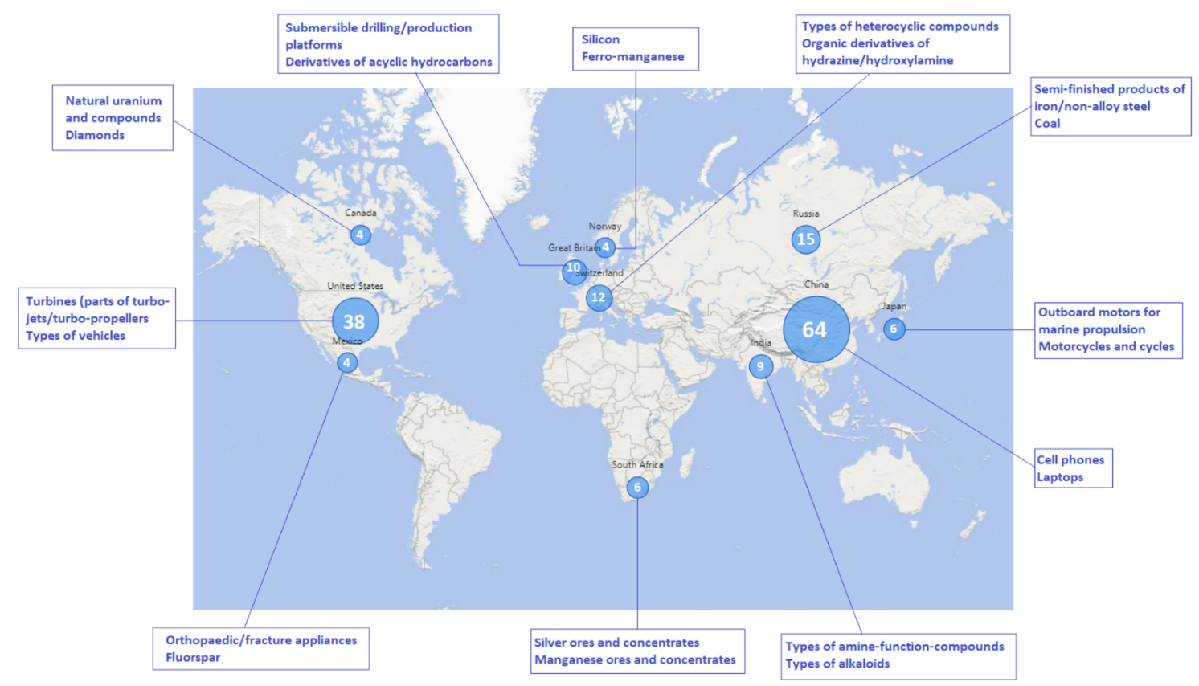
What’s going on?
UNA Europa presentation

Slide 8

Intro: non-economic values
Trade and non-trade interests
Whose interests?

Slide 9
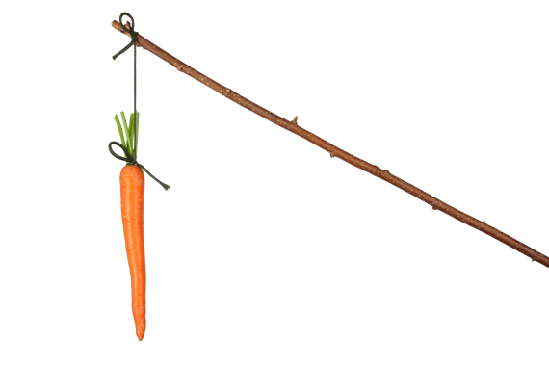
Why integrate trade and non-trade issues?
Classic idea:
Manage effects of trade (no detrimental impact)
Alternative idea:
Use trade to shape conduct in non-trade matters (beneficial impact)
UNA Europa presentation

Slide 10
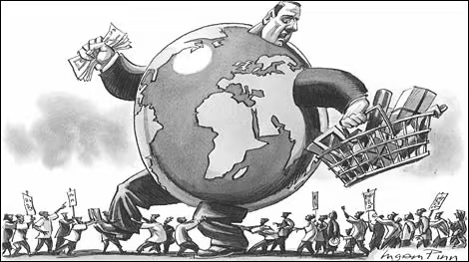
Integration at work
  Harnessing globalisation
  – shift towards
  Remedying globalisation
UNA Europa presentation

Slide 11
2017 EESC white paper
UNA Europa presentation

Slide 12
2022 Power of trade partnerships
UNA Europa presentation

Slide 13

Fullest list to date – NZ/EU
Labour;
Gender equality;
Environmental agreements;
Climate change and fossil fuels transition;
Biodiversity;
Forests;
Fisheries;
Green trade;
CSR;
Protection of indigenous people.
UNA Europa presentation

Slide 14
Impact assessment EU-India
UNA Europa presentation

Slide 15
Why does the EU even conclude FTAs?
UNA Europa presentation

Slide 16
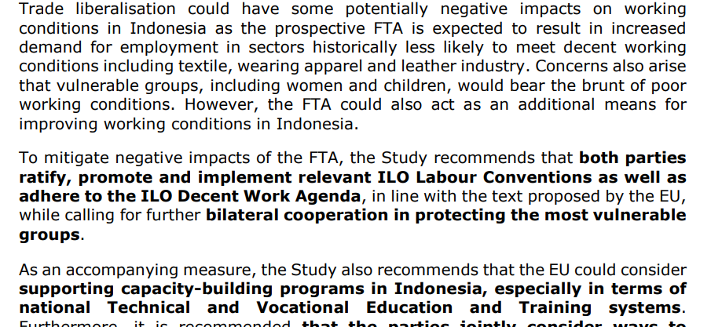
Impact assessment: EU-Indonesia
UNA Europa presentation

Slide 17
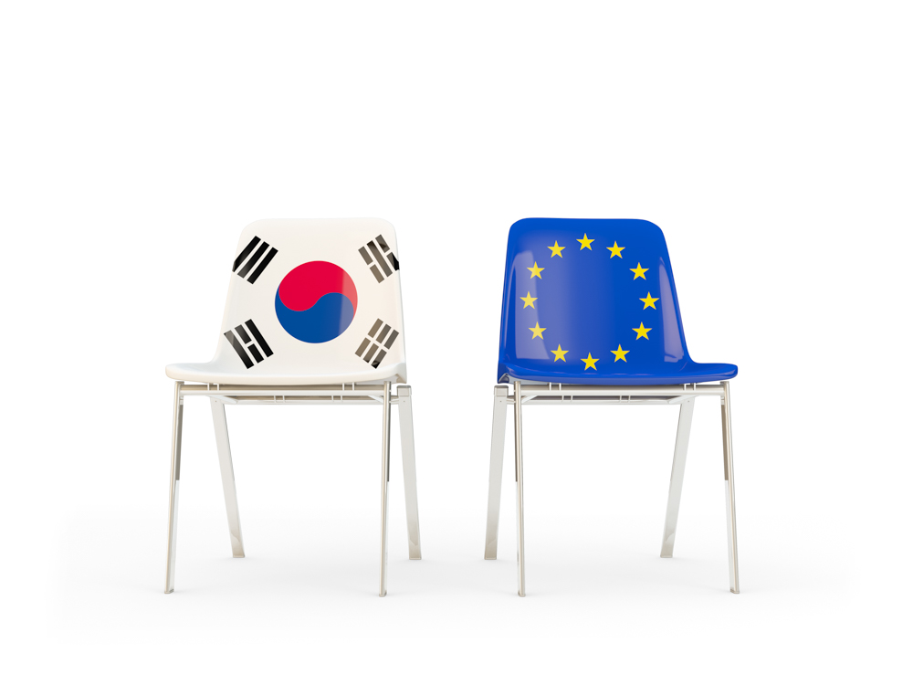
EU-Korea dispute on labour rights
Except as otherwise provided in this Chapter, this Chapter applies to measures adopted or maintained by the Parties affecting trade-related aspects of labour and environmental issues
UNA Europa presentation

Slide 18
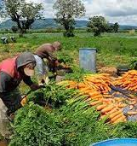
- digression: US-Guatemala dispute
Panel finds that US allegations do not relate to measures that affect trade, so rejects claim
UNA Europa presentation

Slide 19
EU-Korea dispute on labour rights
In case of core ILO rights, there’s an exception to the “trade” focus.
Korea found to breach FTA rules
UNA Europa presentation

Slide 20
USMCA rapid reaction labour dispute scheme
Not limited to trade-affecting measures/practice
UNA Europa presentation

Slide 21
Japan-EU FTA chapter on corporate governance
Why include?
Change culture or lower barrier?
UNA Europa presentation

Slide 22
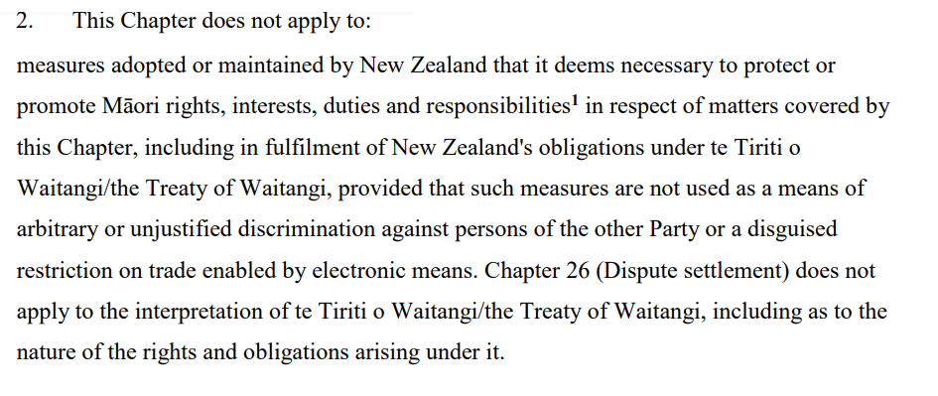
Indigenous people?
https://mostfavourednation.substack.com/p/most-favoured-nation-digital-trade
UNA Europa presentation

Slide 23
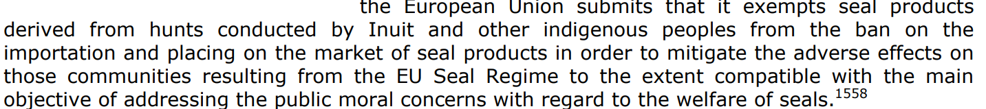
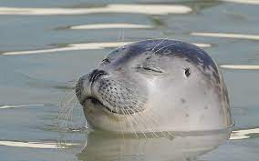
Indigenous people?
UNA Europa presentation

Slide 24
Gender provisions in FTAs
UNA Europa presentation

Slide 25
Gender and trade?
Reaffirming existing commitments
No dumping
Cooperation on policies
Dispute settlement
UNA Europa presentation

Slide 26
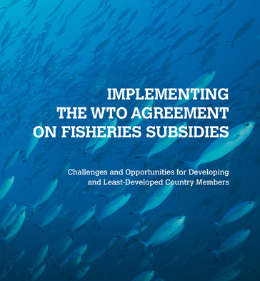
Trade-related and non trade-related duties
Another instance: the WTO deal on fisheries
Different concept of «harmful subsidy»
UNA Europa presentation

Slide 27

Perhaps...
FTAs under stretch (see TTIP, Mercosur, Indonesia impact assessment) for needing to accommodate trade and non-trade goals;
Due diligence exercise? And rather pursuit through unilateral/club measures?
UNA Europa presentation

Slide 28

Easier to operate unilaterally?
Either through market access regulations or unilateral preferential schemes like GSP+
Jump altogether the transactional function of FTAs
UNA Europa presentation

Slide 29

Other instruments...
Forestry
Due diligence
Forced labour
Critical minerals
No need to negotiate, rather use Brussels effect
UNA Europa presentation

Slide 30
@una_europa
#Una_Europa
Thanks!

